Slide 1


MODULE 4 CHALLENGES IN BI
CHALLENGES & ISSUES

Slide 2
Critical challenges for BI Success
Too expensive and hard to justify the ROI of BI
Lack of company-wide adoption
Analyzing data from different data sources
Businesses aren’t measuring the right indicators
Delivering mobile-based BI is no easy feat
Providing true self-service analytics
Dealing with the impact of poor data quality
Lacking a clearly defined BI strategy

Slide 3

DATA CHALLENGES
Poor BI functionality & interactivity
Sluggish query and database performance
Integrating Data from Various Source Systems
Data Quality Issues
Data Silos with Inconsistent Information

Slide 4

IMPORTANCE OF CROSS COLLABORATION
01
04
Enhanced Decision-Making
Data Integration and Consistency
02
05
Continuous Improvement
Comprehensive Insights
03
06
Alignment with Business Goals
Change Management and Adoption

Slide 5



SALES & MARKETING PERSPECTIVE
Customer Segmentation and Targeting
Improved Lead Generation and Conversion
Sales Performance Tracking and Analysis

Slide 6
SALES & MARKETING PERSPECTIVE
Marketing Campaign Optimization
Customer Insights and Retention
Marketing ROI Measurement

Slide 7
INCREASING SUPPORT FOR DECISIONS
Integration with Decision-Making Processes, Continuous Monitoring, and Measurement
Access to Timely and Relevant Information
Scenario Analysis and What-If Modeling
Collaborative Decision-Making
Predictive Analytics and Forecasting
Data Visualization and Reporting
Ad Hoc Querying and Analysis

Slide 8
BUSINESS SPONSOR
Project Governance and Oversight
Advocacy and Influence
Executive Alignment
Sponsors are senior leaders or executives who provide the necessary support, resources, and direction for the BI initiative. They play a vital role in securing funding, aligning the initiative with strategic goals, and ensuring organizational buy-in. Sponsors also help overcome barriers and facilitate decision-making processes.
Change Management
Continuous Support and Improvement
Parameters
Notes:
IF only someone would sponsor for quality education here

Slide 9


BUSINESS REPRESENTATION
Performing Due Diligence
Developing a Strategy and Business Plan
Establishing a Local Team
Product Readiness
Organizational Readiness
Establishing a Go-to-Market Strategy
Legal Readiness
Tax and Finance Readiness
Preparation of your Final Budget
Establish Close Relationships with Local Businesses explain each point
87%

Slide 10

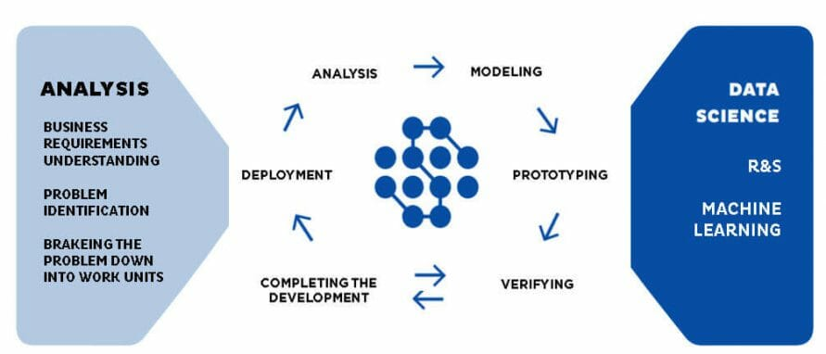
BI IMPLEMENTATION
Visualize
Planning And Architecture
Develop And Implement
Deployment
Maintain

Slide 11
VISUALISE
PLANNING AND ARCHITECTURE
Analyze information needs
Information strategy Roadmap
Enterprise level KPIS
Define Requirements
Define Attributes
Define Measures
Identify Granularity or level of analysis
Analyze Source Systems and Technical Environment
Analyze Source systems and Identify gaps
Analyze technical Environment
Design Solution Architecture
Overall system architecture
Data architecture
ETL Architecture
BI Application Architecture
DEVELOP AND IMPLEMENT
Build Infrastructure
Database, ETL, BI Development
System test
User Acceptance Testing
Documentation

Slide 12
DEPLOYMENT
Deployment Readiness
Production deployment
MAINTAIN
System Administration
Monitoring and Performance Tuning

Slide 13

PLANNING THE BI PROJECTS
Create a solid BI implementation project plan
Define goals and objectives
Consult with key stakeholders
Keep in mind your team and budget
Clear the clutter and define a timeframe
Step back from the computer
Define your data sources and gather the data

Slide 14
PLANNING THE BI PROJECTS
Clean your data and assess the quality
Implement a data governance plan
Concentrate on technicalities
Implement your BI solution and measure success
Work on a support and training system
Finally, communicate regularly

Slide 15
REAL LIFE APPLICATIONS
Data science is extensively used in image analysis for medical diagnostics.
It plays a crucial role in genetics and genomics research and analysis.
Data science contributes to drug development by analyzing large datasets and predicting drug efficacy.
Data science algorithms enable targeted advertising based on user preferences and behavior.
Website recommendations and personalized marketing campaigns are powered by data science techniques.
E-commerce platforms utilize data science for analyzing consumer behavior and improving user experience.
Data science algorithms drive speech recognition technologies used in virtual assistants like Siri and Google Assistant.
Advanced image recognition techniques are used in various applications, such as facial recognition and object detection.
Data science helps in developing self-driving cars by analyzing fuel usage trends, driver behavior, and vehicle tracking
Healthcare
Digital Marketing and Advertising
Speech and Image Recognition
Transportation

Slide 16
REAL LIFE APPLICATIONS
Data science plays a vital role in enhancing security measures by detecting fraudulent activities based on user patterns
Data science enables businesses to gain valuable insights into customer behavior, demographics, and interests for targeted marketing strategies.
Data science contributes to the development of augmented reality experiences by integrating computer expertise, algorithms, and data analysis.
Security
Customer Insights
Augmented Reality

Slide 17

NO JOKES ONLY PAIN!

